Slide 1
INTERIOR HIGHLANDS
AND MISSISSIPPI EMBAYMENT
John L. Harris
Arkansas State Highway and Transportation Department
Little Rock, Arkansas
Department of Biological Sciences - Museum of Zoology Arkansas State University - Jonesboro

Slide 2
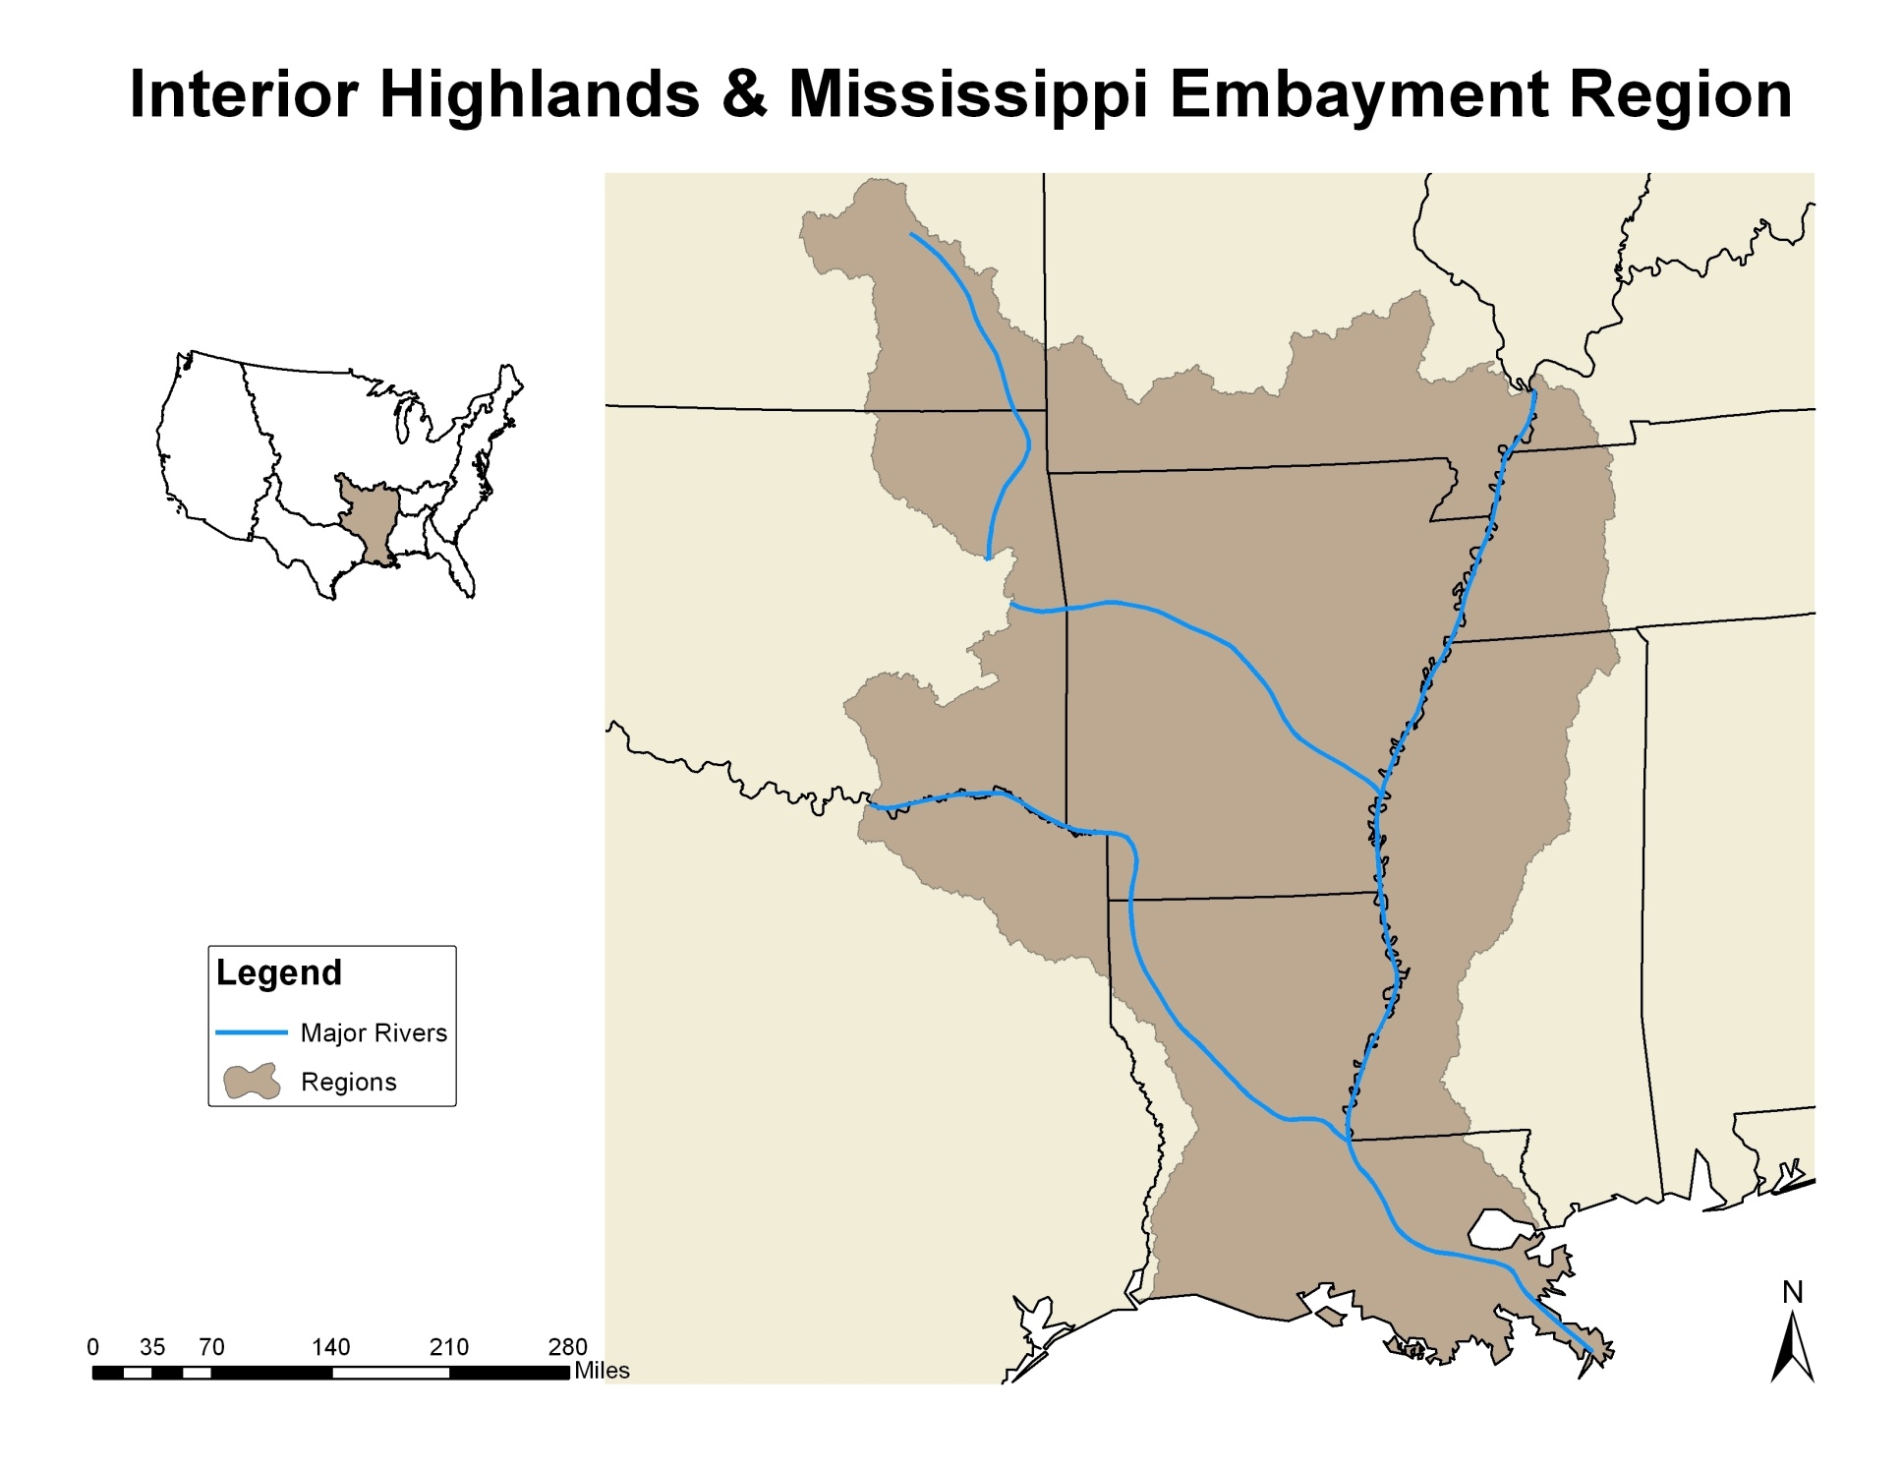

Slide 3
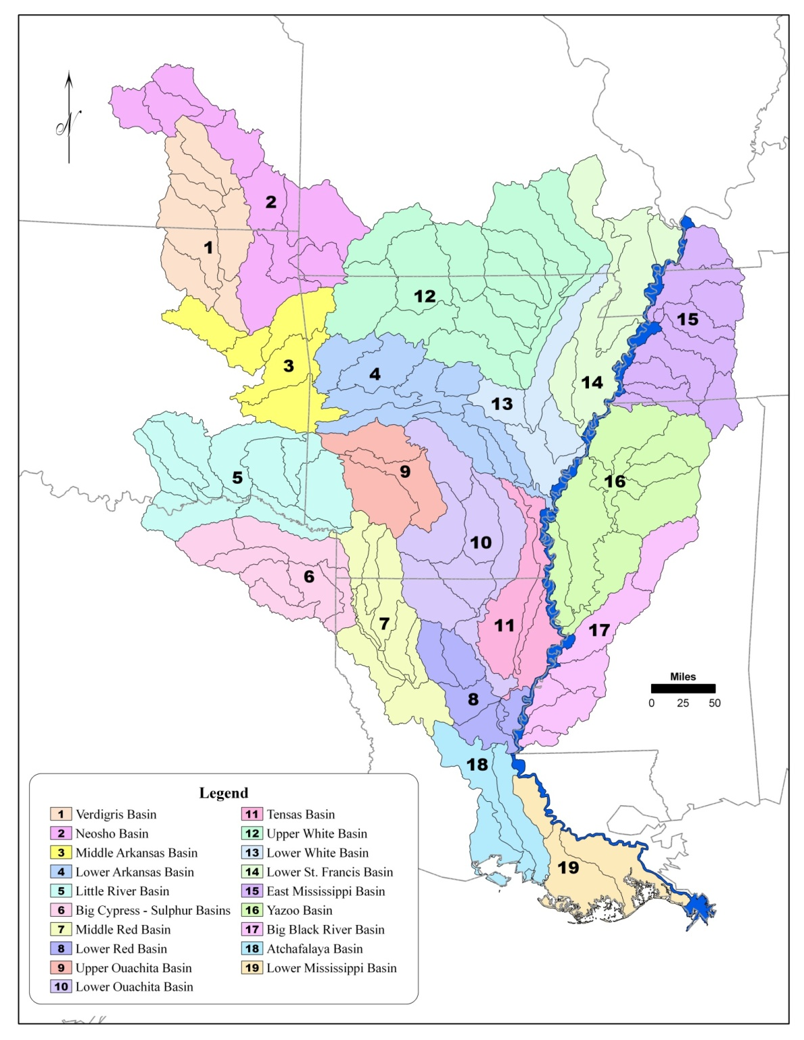
19 River Basins
6-digit Hydrologic Unit Codes
93 Taxa Analyzed
Notes:
Graphic prepared by Linda DeMasi, AHTD.

Slide 4
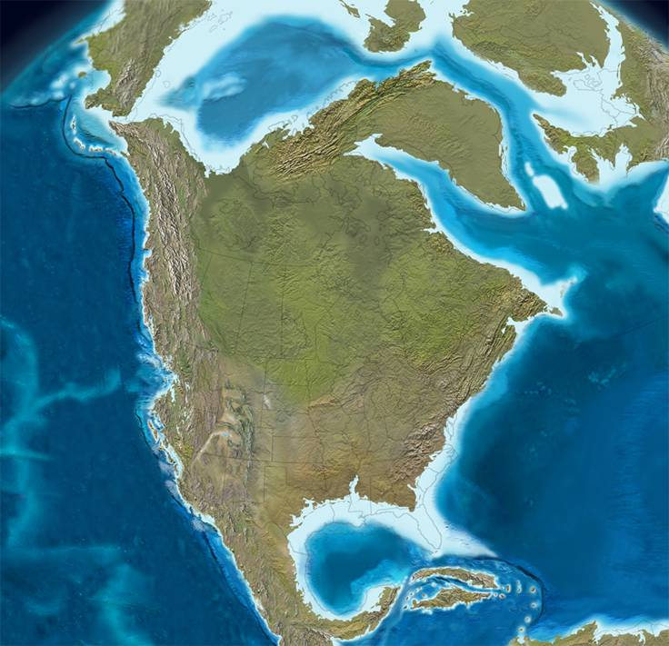
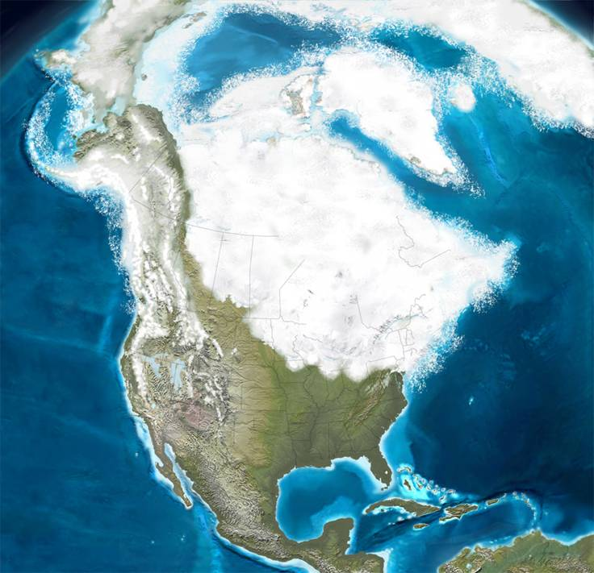

Slide 5
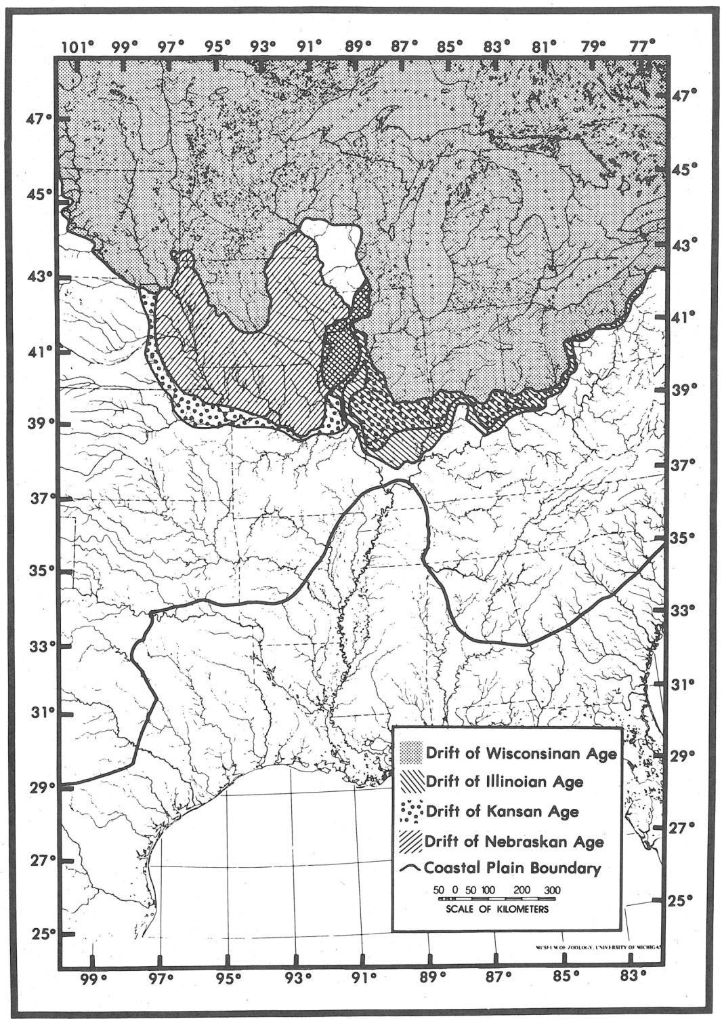
Notes:
Figure reproduced from Burr and Page in The Zoogeography of N.A. Freshwater Fishes, Hocutt and Wiley, eds., 1986.

Slide 6
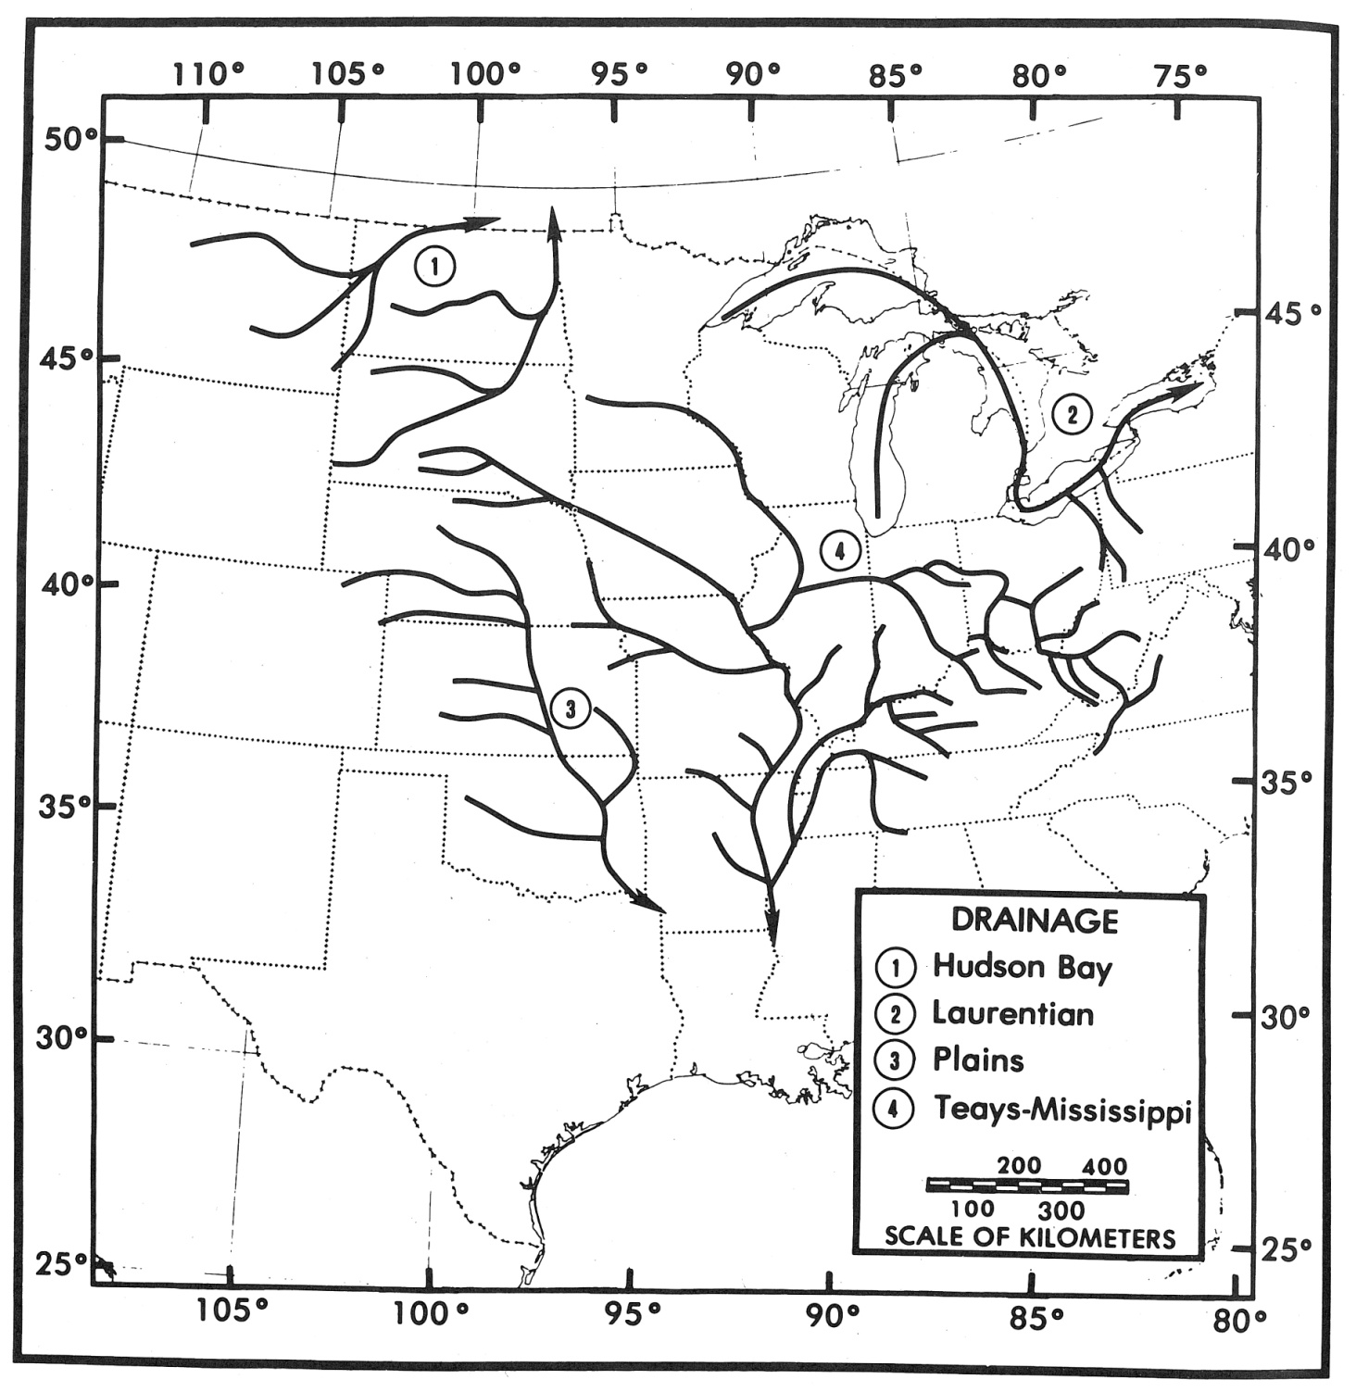
Notes:
Figure reproduced from Burr and Page in The Zoogeography of N.A. Freshwater Fishes, Hocutt and Wiley, eds., 1986.

Slide 7
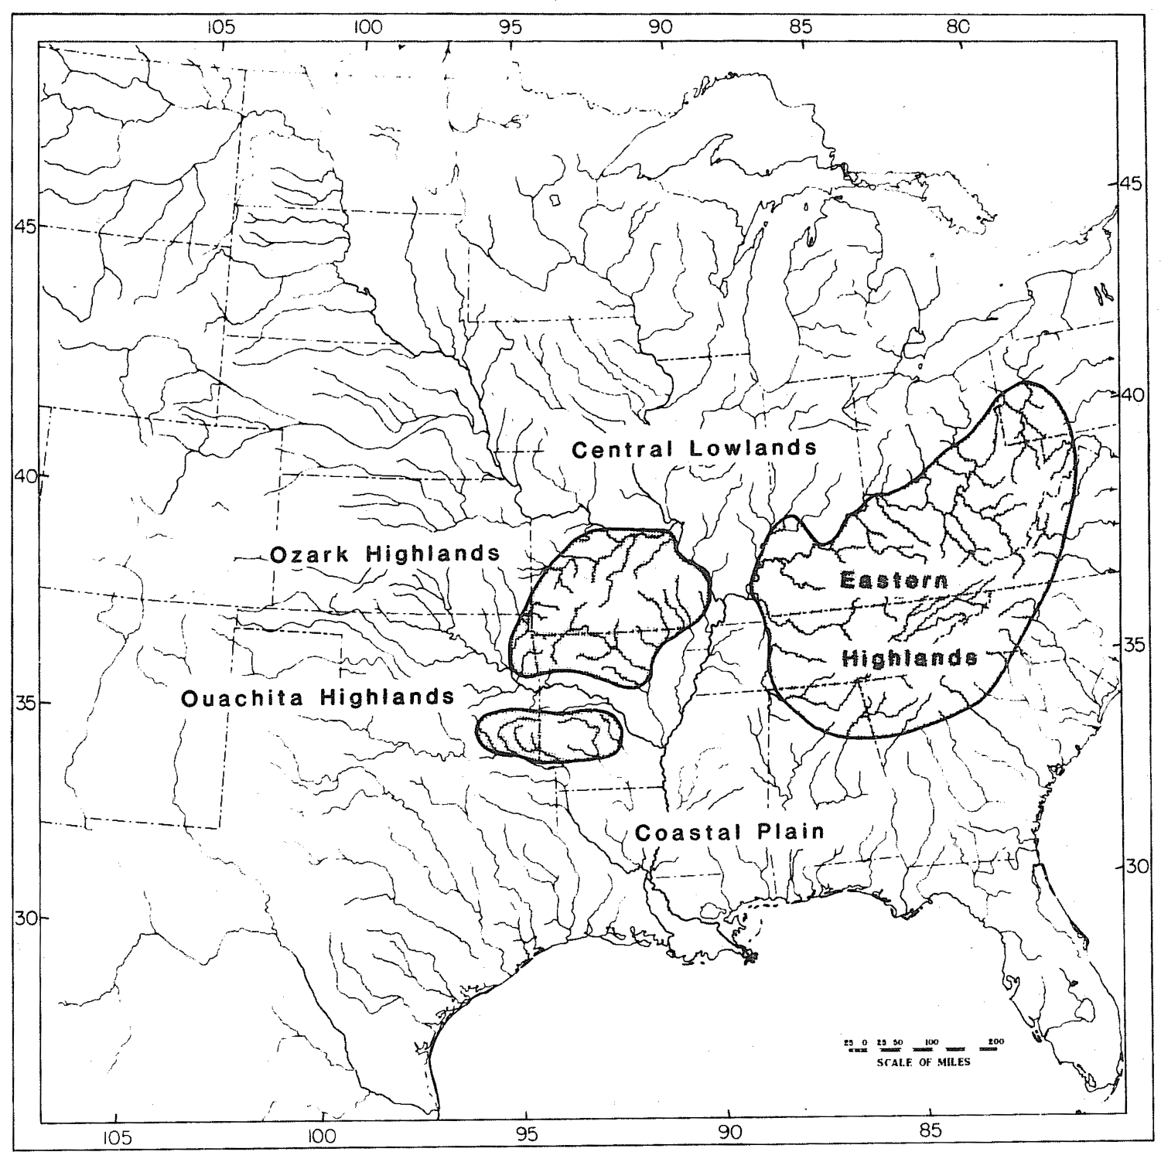
Notes:
Jeez, I forgot where I “borrowed” this figure from.

Slide 8
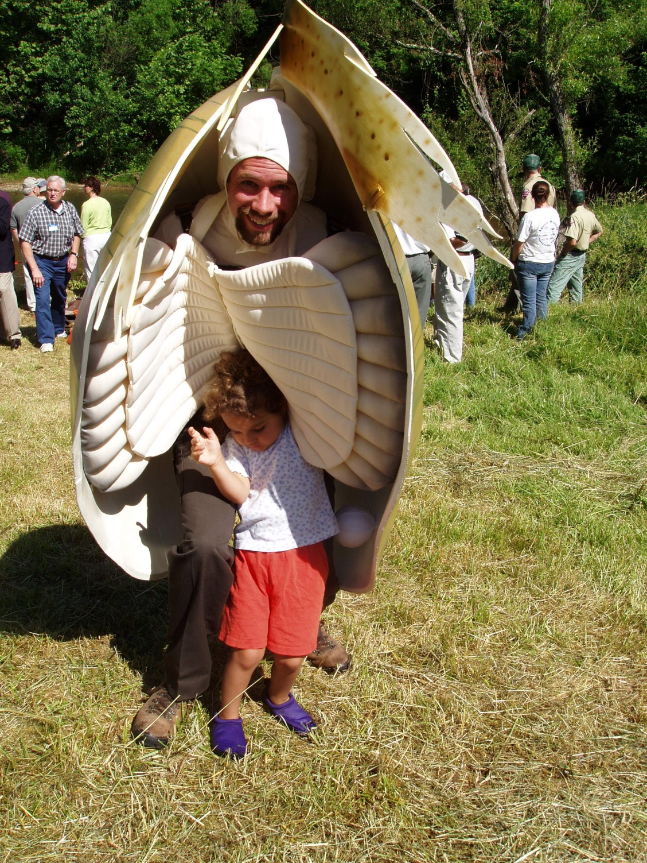
Notes:
Shane Hanlon in his recurring role as Russell the Mussel – who else could play it with such flair? Photo courtesy of U. S. Fish and Wildlife Service.

Slide 9
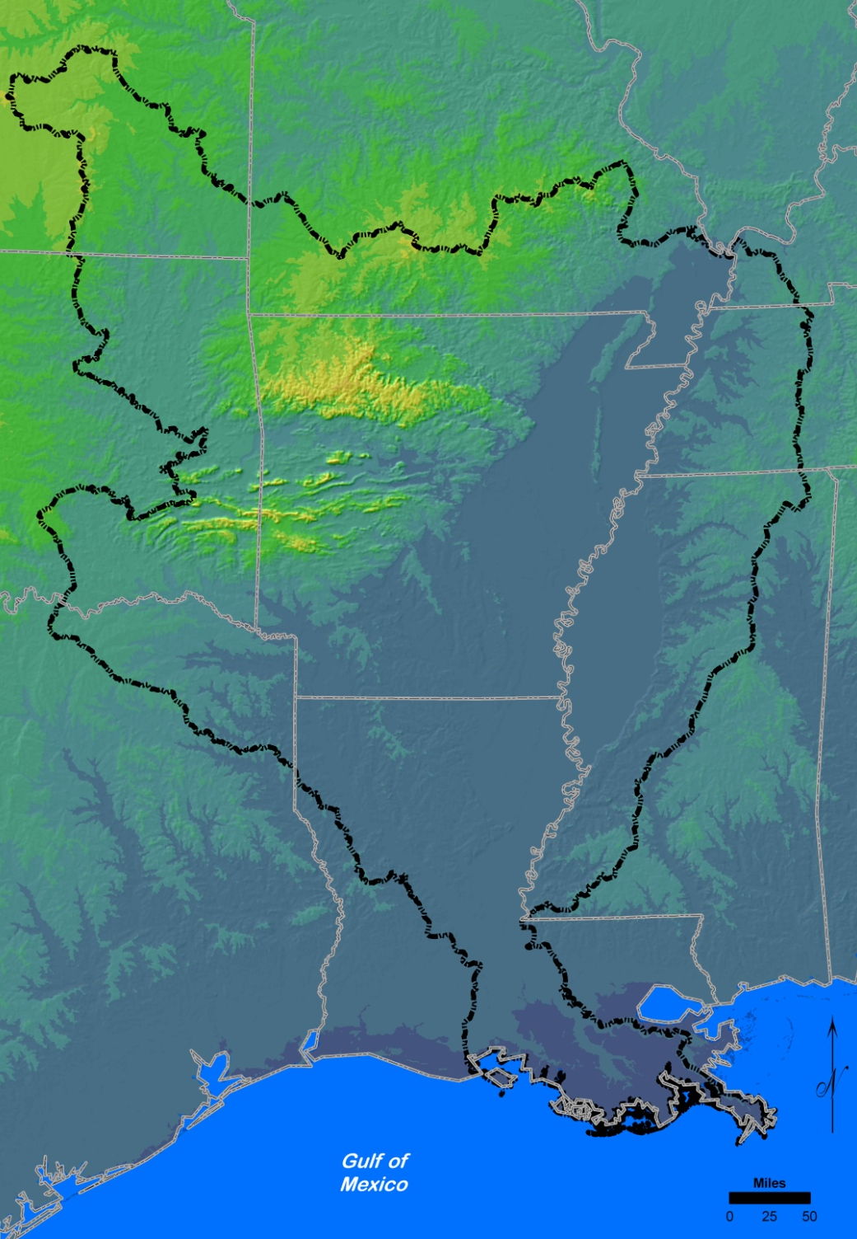
Notes:
Graphic prepared by Linda DeMasi, AHTD.

Slide 10
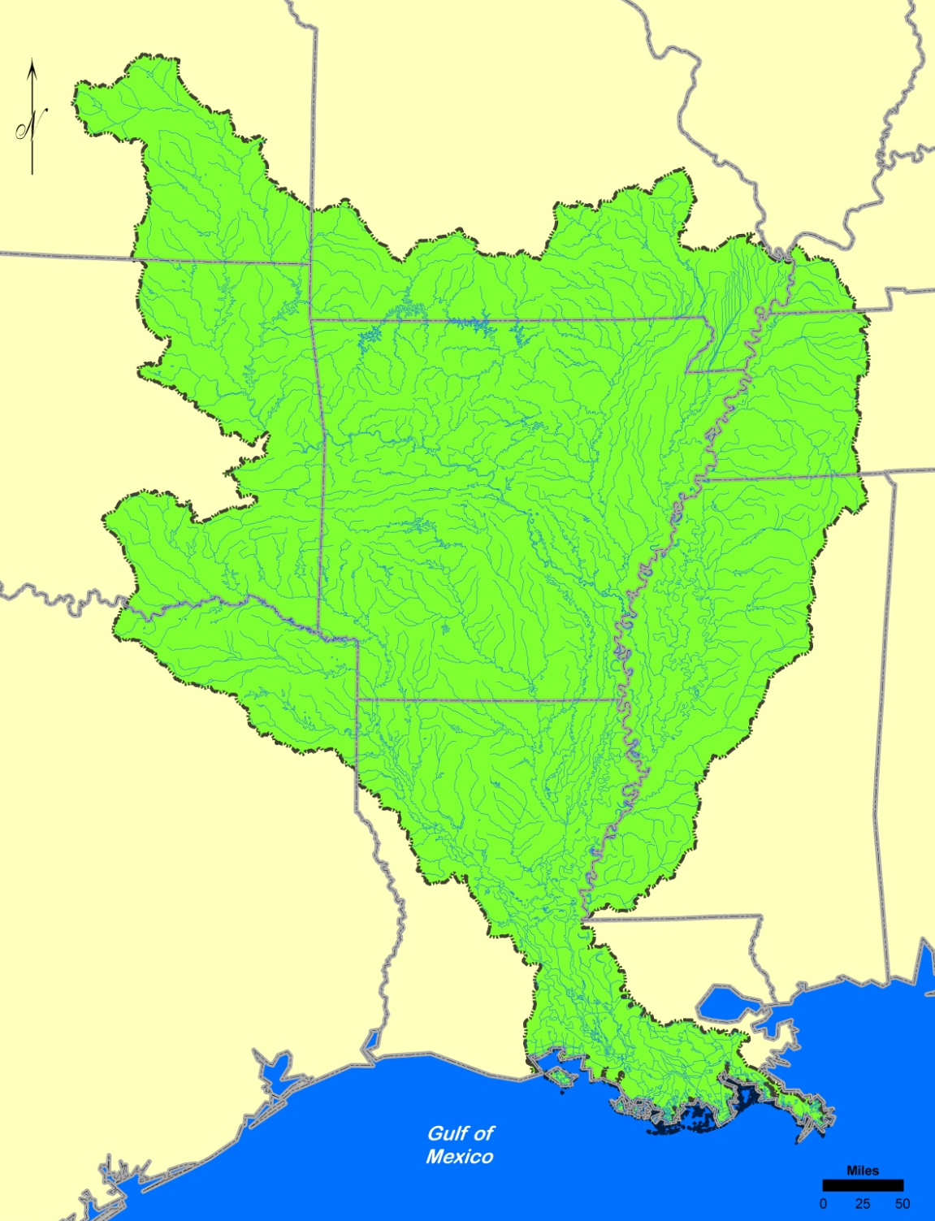
Notes:
Graphic prepared by Linda DeMasi, AHTD.

Slide 11
Widely Distributed Species
22 Taxa
Amblema plicata (Say 1817)
Elliptio dilatata (Rafinesque, 1820)
Fusconaia flava (Rafinesque 1820)
Lampsilis cardium Rafinesque 1820
Lampsilis hydiana (Lea 1838)
Lampsilis teres (Rafinesque 1820)
Leptodea fragilis (Rafinesque 1820)
Ligumia subrostrata (Say 1831)
Megalonaias nervosa (Rafinesque 1820)
Obliquaria reflexa Rafinesque 1820
Potamilus ohiensis (Rafinesque 1820)
Potamilus purpuratus (Lamarck 1819)
Pyganodon grandis (Say 1829)
Quadrula nodulata (Rafinesque 1820)
Quadrula p. pustulosa (Lea 1831)
Quadrula quadrula (Rafinesque 1820)
Quadrula verrucosa (Rafinesque 1820)
Toxolasma parvus (Barnes 1823)
Truncilla donaciformis (Lea 1828)
Truncilla truncata Rafinesque 1820
Utterbackia imbecillis (Say 1829)
Villosa lienosa (Conrad 1834)
threeridge
spike
Wabash pigtoe
plain pocketbook
Louisiana fatmucket
yellow sandshell
fragile papershell
pondmussel
washboard
threehorn wartyback
pink papershell
bleufer
giant floater
wartyback
pimpleback
mapleleaf
pistolgrip
lilliput
fawnsfoot
deertoe
paper pondshell
little spectaclecase

Slide 12
Interior Highlands
Ozark and Ouachita Highlands
Cumberlandia monodonta (Say 1829) spectaclecase
Cyprogenia species fanshells
Lampsilis abrupta (Say 1831) pink mucket
Lampsilis sp. A cf hydiana Arkoma fatmucket
Leptodea leptodon (Rafinesque 1820) scaleshell
Ptychobranchus species kidneyshells

Slide 13
Interior Highlands
Ozark Highland Taxa (12)
Alasmidonta viridis (Rafinesque 1820) slippershell mussel
Cyclonaias tuberculata (Rafinesque 1820) purple wartyback
Epioblasma florentina curtisii Curtis pearlymussel
(Frierson & Utterback 1916)
Epioblasma triquetra (Rafinesque 1820) snuffbox
Epioblasma turgidula (Lea 1858) turgid blossom
Fusconaia ozarkensis (Call 1887) Ozark pigtoe
Lampsilis rafinesqueana Frierson 1927 Neosho mucket
Lampsilis r. reeveiana (Lea 1852) Arkansas brokenray
Lampsilis streckeri Frierson 1927 speckled pocketbook
Simpsonaias ambigua (Say 1825) salamander mussel
Venustaconcha ellipsiformis (Conrad 1836) ellipse
Venustaconcha pleasii (Marsh 1891) bleedingtooth mussel

Slide 14
Interior Highlands
Ouachita Highland Taxa
Arkansia wheeleri (Ortmann and Walker 1912) Ouachita rock pocketbook
Lampsilis ornata (Conrad 1835) southern pocketbook
Lampsilis powellii (Lea 1852) Arkansas fatmucket
Lampsilis sp. B cf hydiana Red River fatmucket
Quadrula fragosa (Conrad 1835) winged mapleleaf
Villosa arkansasensis (Lea 1862) Ouachita creekshell

Slide 15
Mississippi Embayment Taxa (13)
Anodontoides radiatus (Conrad 1834) rayed creekshell
Margaritifera hembeli (Conrad 1838) Louisiana pearlshell
Potamilus capax (Green 1832) fat pocketbook
Elliptio crassidens (Lamarck 1819) elephantear
Lampsilis straminea claibornensis (Lea 1838) southern fatmucket
Obovaria subrotunda (Rafinesque 1820) round hickorynut
Pleurobema plenum (Lea 1840) rough pigtoe
Potamilus alatus (Say 1817) pink heelsplitter
Quadrula mortoni (Conrad 1835) western pimpleback
Quadrula refulgens (Lea 1868) purple pimpleback
Uniomerus carolinianus (Bosc 1801) Florida pondhorn
Uniomerus declivis (Say 1831) tapered pondhorn
Villosa vibex (Conrad 1834) southern rainbow

Slide 16
Taxon (19) Type Locality
Arcidens confragosus Bayou Teche, St. Mary Parish, Louisiana
Arkansia wheeleri Old River, Arkadelphia, Arkansas
Cyprogenia aberti Chamber's Ford rapids of
Verdigris River, Oklahoma
Epioblasma florentina curtisii White River, Hollister, Missouri
Fusconaia ozarkensis White and Current rivers of Arkansas
and Missouri; and Jack’s Fork of the
Current River, Missouri.
Lampsilis hydiana Bayou Teche, Louisiana
Lampsilis powellii Saline River, Arkansas
Lampsilis rafinesqueana Indian Creek, McDonald County, Missouri
Lampsilis r. reeveiana White River, Arkansas
Lampsilis streckeri Little Red River, Arkansas
Margaritifera hembeli Bayou Boeuf, Louisiana
Ptychobranchus occidentalis Current River , Arkansas
Quadrula apiculata New Orleans, Louisiana
Quadrula mortoni Bayou Teche, Louisiana
Quadrula nobilis Bayou Teche, Louisiana
Uniomerus declivus Bayou Teche, Louisiana
Uniomerus tetralasmus Bayou St. John near New Orleans, Louisiana
Venustaconcha pleasii Little Red River, Arkansas
Villosa arkansasensis Hot Springs, Arkansas

Slide 17
Federally Listed or Proposed Species (14)
Arkansia wheeleri (Ortmann and Walker 1912) Ouachita rock pocketbook
Cyprogenia stegaria (Rafinesque 1820) fanshell
Epioblasma florentina curtisii Curtis pearly mussel
(Frierson and Utterback 1916)
Epioblasma turgidula (Lea 1858) turgid blossom
Lampsilis abrupta (Say 1831) pink mucket
Lampsilis powellii (Lea 1852) Arkansas fatmucket
Lampsilis streckeri Frierson 1927 speckled pocketbook
Leptodea leptodon (Rafinesque 1820) scaleshell
Margaritifera hembeli (Conrad 1838) Louisiana pearlshell
Pleurobema plenum (Lea 1840) rough pigtoe
Potamilus capax (Green 1832) fat pocketbook
Quadrula fragosa (Conrad, 1835) winged mapleleaf
Cumberlandia monodonta (Say 1829) spectaclecase
Lampsilis rafinesqueana Frierson 1927 Neosho mucket

Slide 18
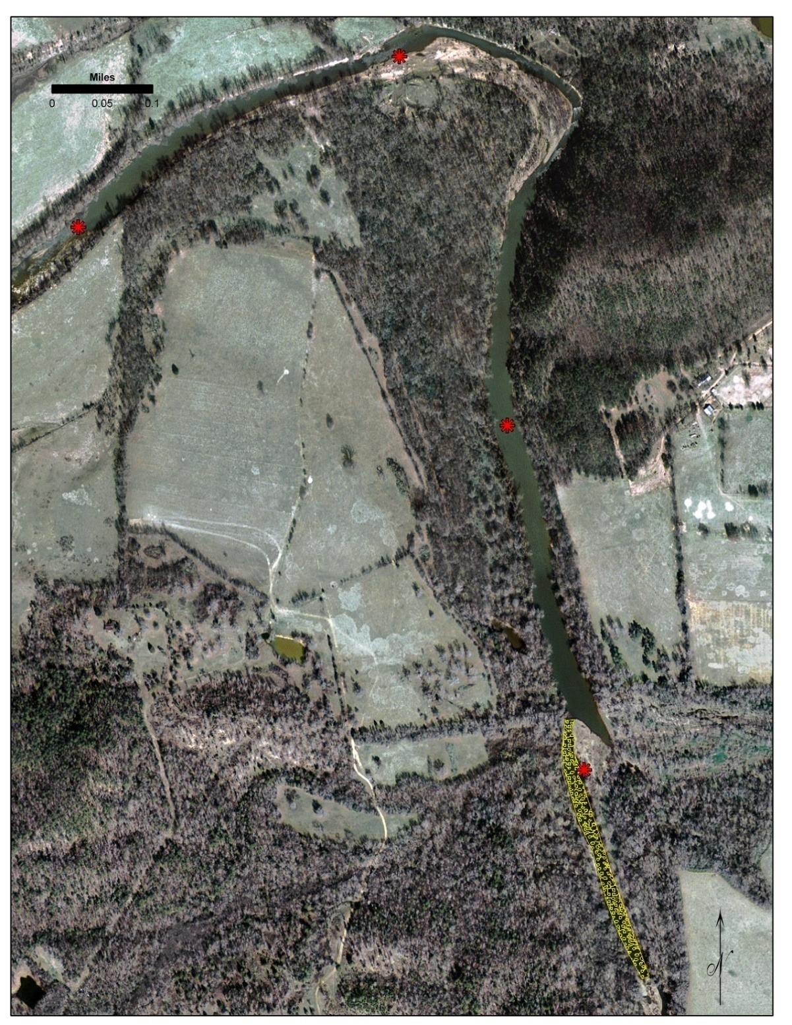
Headwaters Mussel Assemblage Locations
Ouachita River, AR

Slide 19
Mid-size River Mussel Assemblage Locations
Saline River, AR
Notes:
Figure reproduced from Andrew J. Peck dissertation, Arkansas State University, 2010.

Slide 20
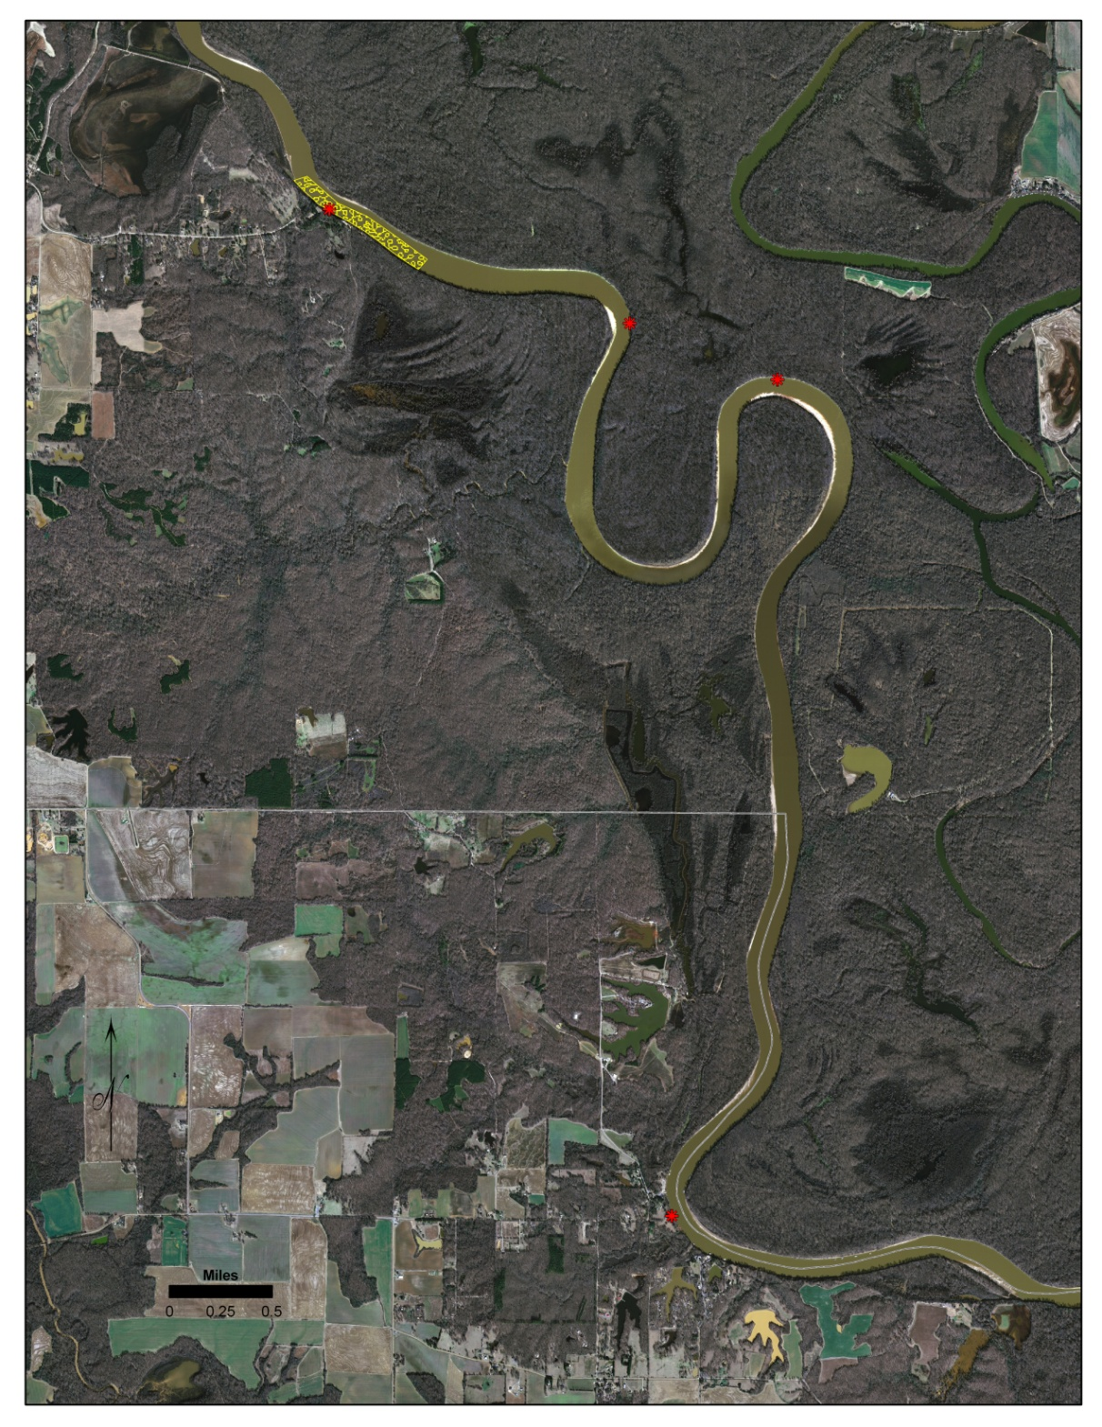
Large River Mussel Assemblage Locations
White River, AR
Notes:
Graphic prepared by Linda DeMasi, AHTD.

Slide 21
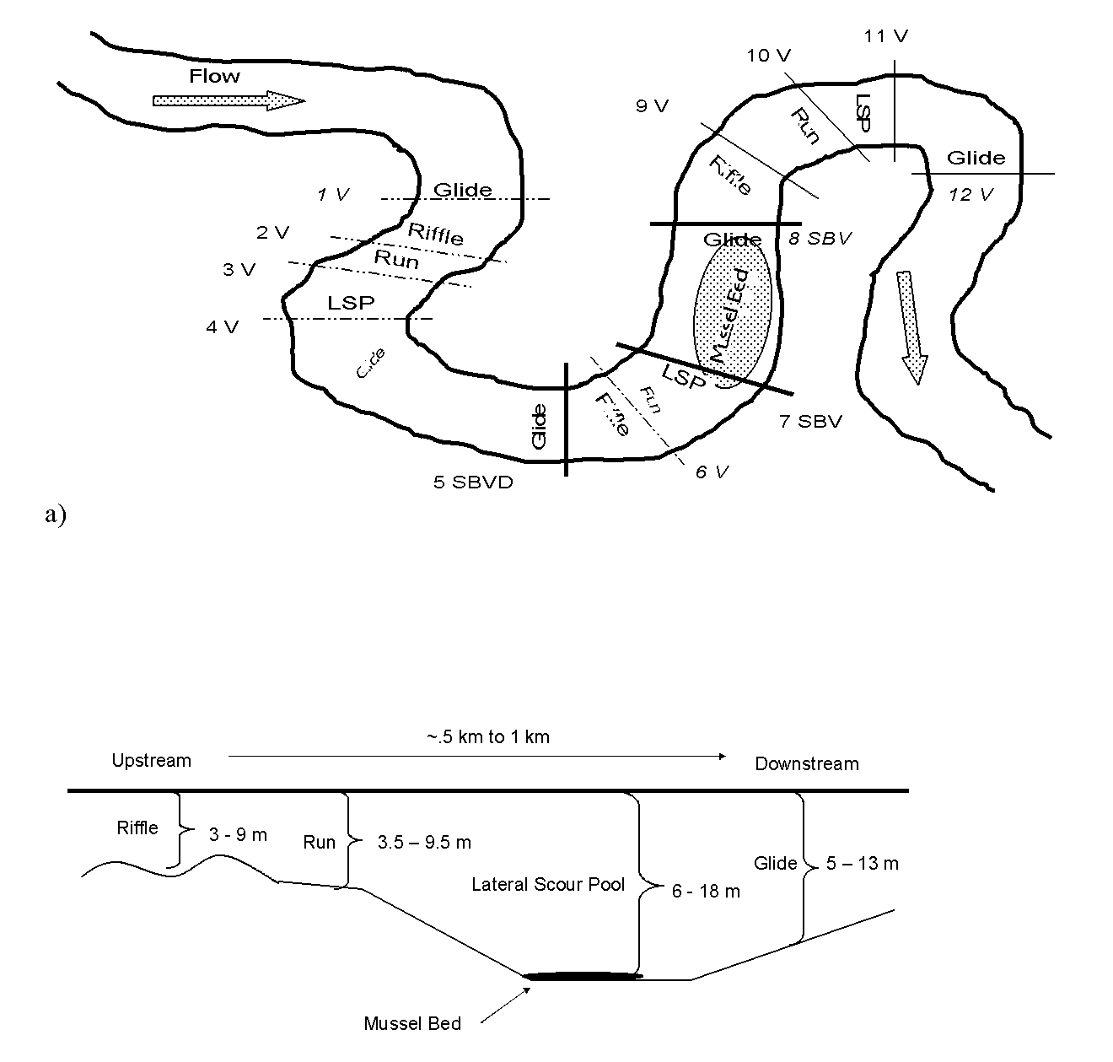
Notes:
Figure reproduced from Andrew J. Peck thesis, Arkansas State University, 2005.

Slide 22

Spring and Black Rivers
(White River Basin)
Arkansas and Missouri
~ 50 species
Cyprogenia species
Cyprogenia stegaria
Epioblasma curtisii
Epioblasma triquetra
Fusconaia ozarkensis
Lampsilis abrupta
Leptodea leptodon
Quadrula c. cylindrica
Simpsonaias ambigua
Notes:
Graphic prepared by Linda DeMasi, AHTD.

Slide 23

St. Francis River
Arkansas and Missouri
~ 50 species
Cyprogenia stegaria
Lampsilis abrupta
Pleurobema species
Potamilus capax
Quadrula c. cylindrica
Notes:
Graphic prepared by Linda DeMasi, AHTD.

Slide 24

Kiamachi and Little Rivers
Arkansas and Missouri
~ 40 species
Arkansia wheeleri
Leptodea leptodon
Pleurobema riddellii
Quadrula c. cylindrica
Quadrula fragosa
Notes:
Graphic prepared by Linda DeMasi, AHTD.

Slide 25

Saline River
(Lower Ouachita Basin)
Arkansas
~ 45 species
Lampsilis ornata
Lampsilis powellii
Quadrula c. cylindrica
Quadrula fragosa
Pleurobema riddellii
Notes:
Graphic prepared by Linda DeMasi, AHTD.

Slide 26
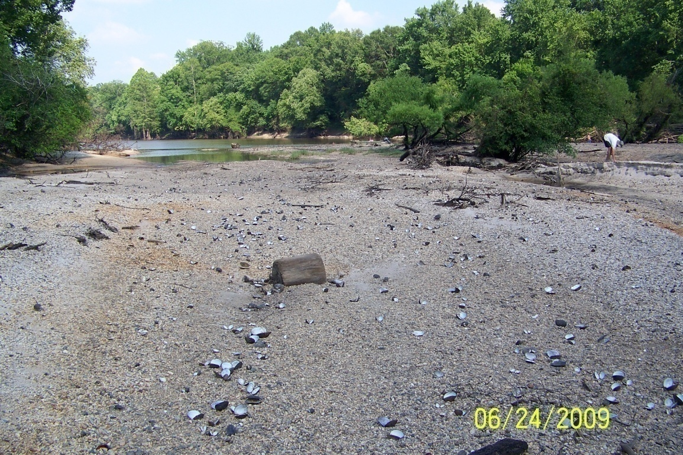
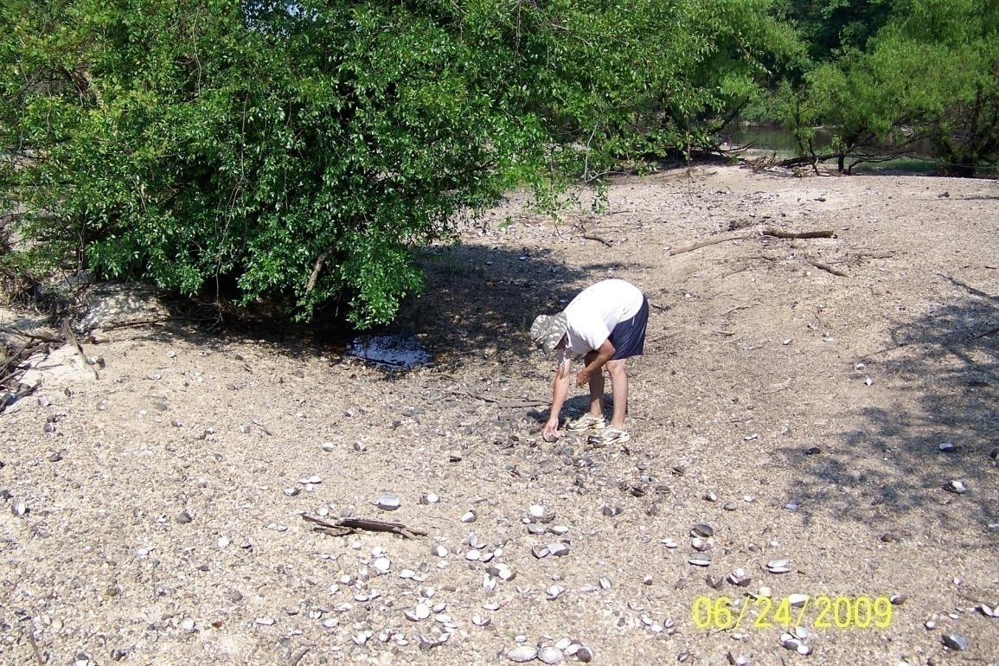
Saline River, AR
Post-flood

Slide 27

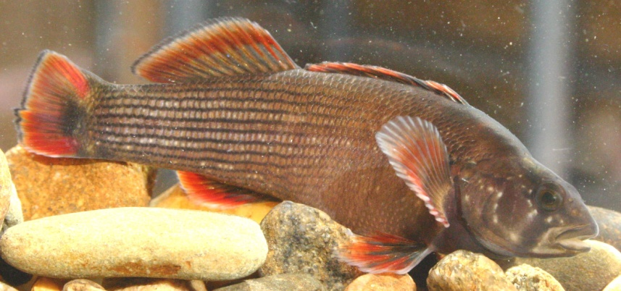
Little Red River
Arkansas
Etheostoma moorei
(yellowcheek darter)
Lampsilis streckeri
Anodontoides ferussacianus
Cyprogenia species
Obovaria species
Pleurobema species
Quadrula c. cylindrica
“Villosa” species
Notes:
Graphic prepared by Linda DeMasi, AHTD.

Slide 28
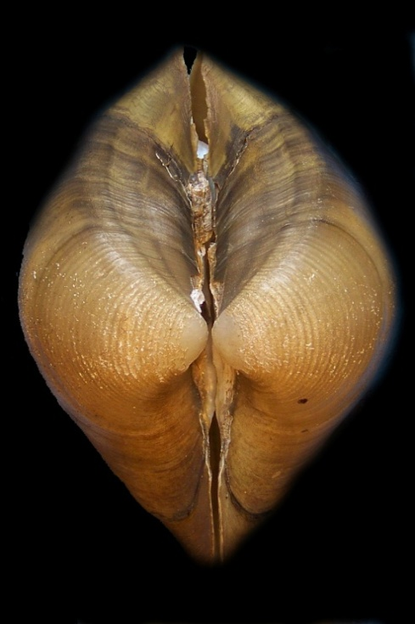
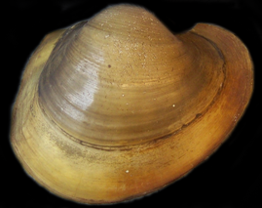
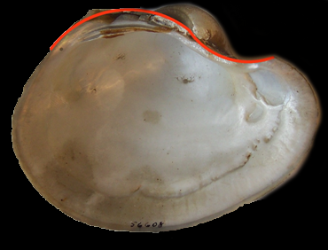
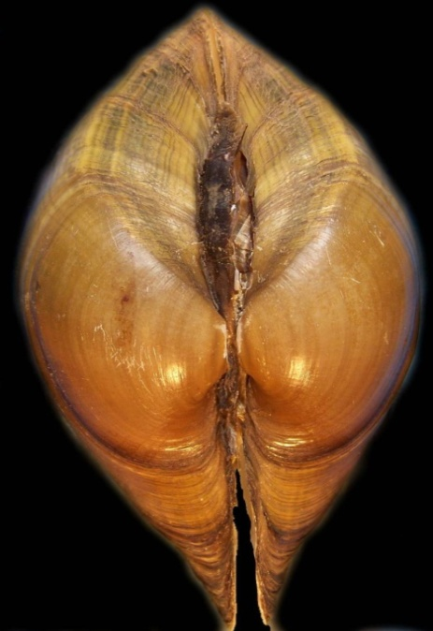
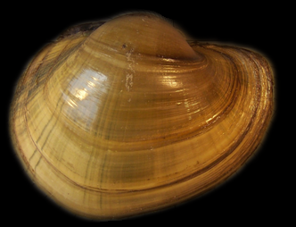
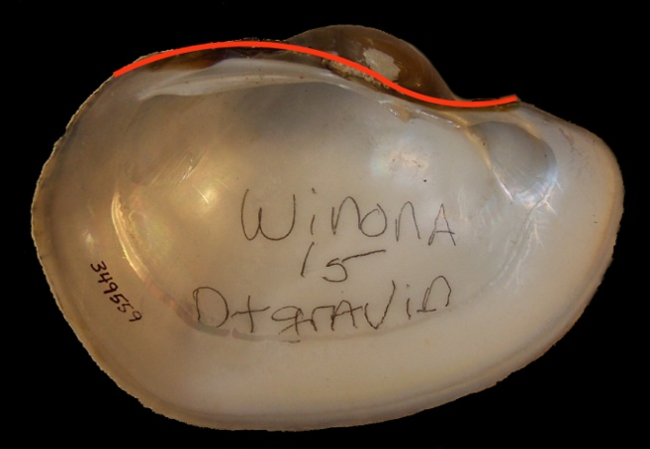
Potamilus capax (top), Lampsilis cardium (bottom)

Slide 29
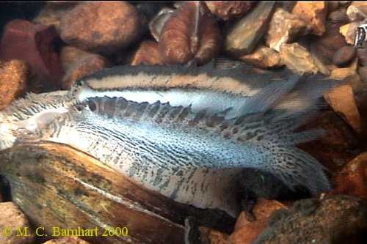

Slide 30
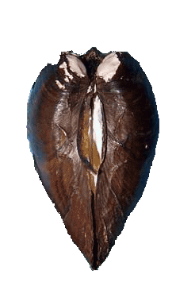
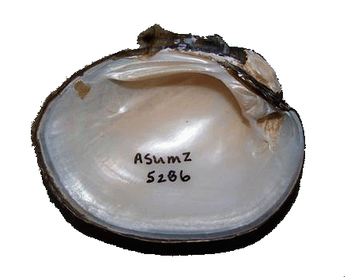
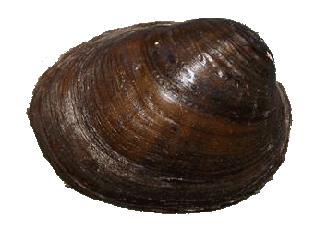
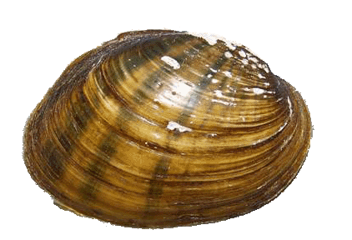
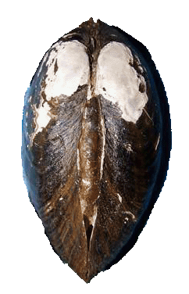
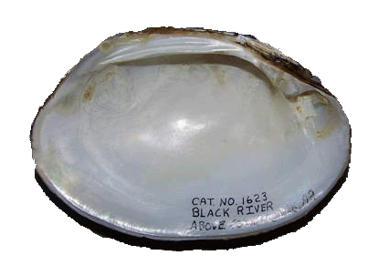
Lampsilis abrupta (top)
Actinonaias ligamentina (below)

Slide 31
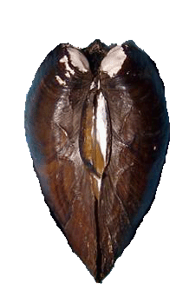
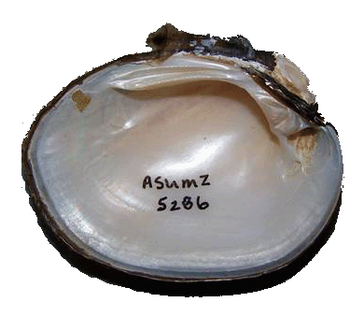
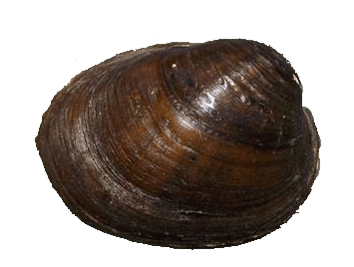
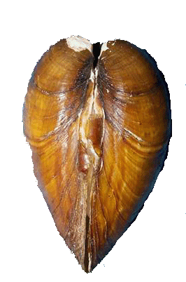
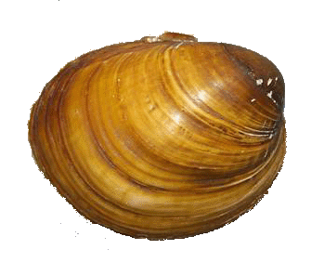
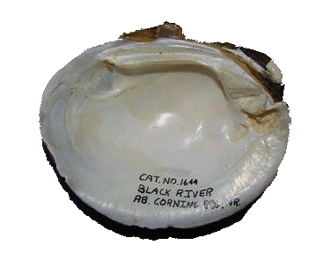
Lampsilis abrupta (top), Obovaria olivaria (bottom)

Slide 32
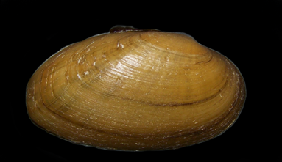
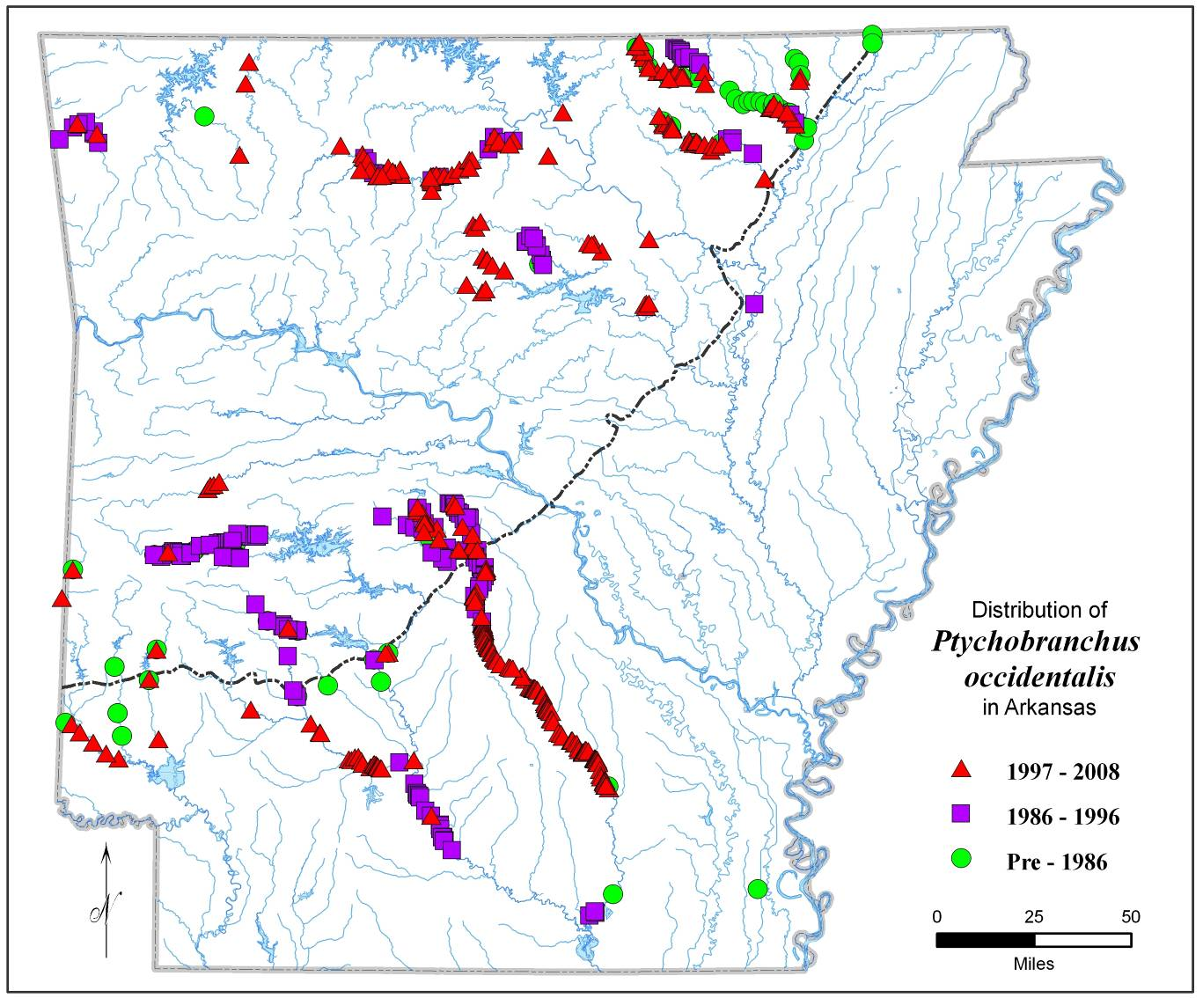
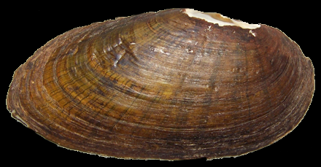
Ptychobranchus species
Notes:
Top: Ptychobranchus from White River drainage, AR. Bottom: Ptychobranchus from Ouachita River drainage, AR.

Slide 33
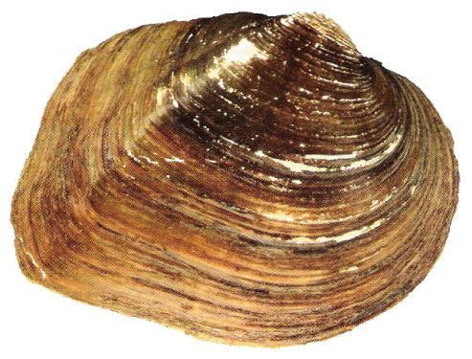
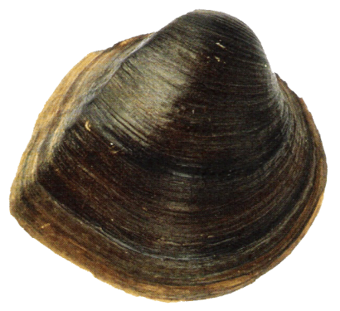
Shell Morphology
Shell shape can be varied among populations in different habitat types
“Ortmann’s Law” (Ortmann, 1920)
  Correlation of shell shape and river position
    Flat, rough, and compressed
      Headwaters
    Inflated, smooth, and heavy
      Large rivers
Headwater form
Large river form

Slide 34
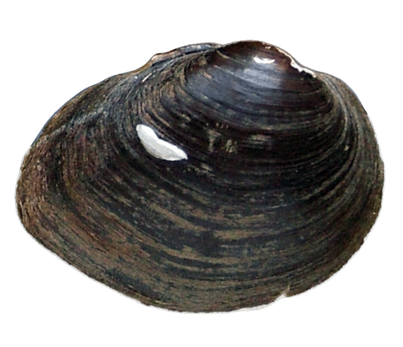
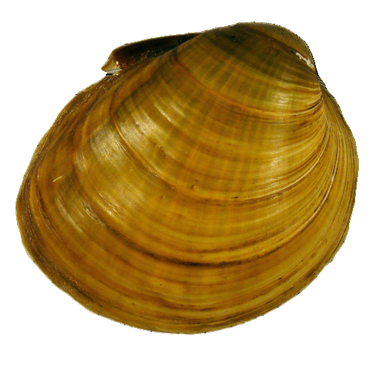
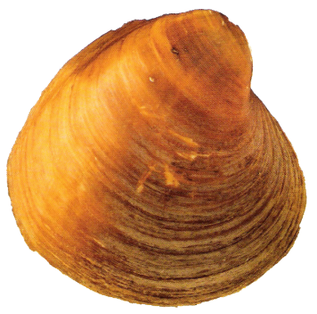
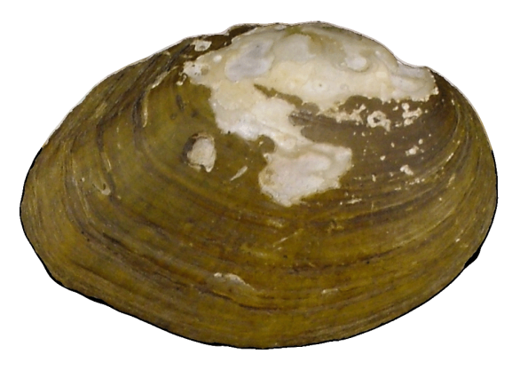
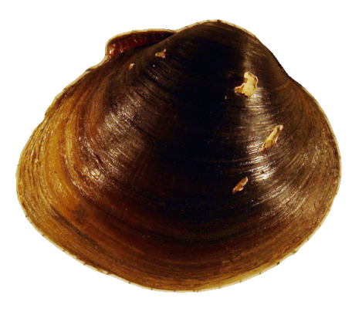
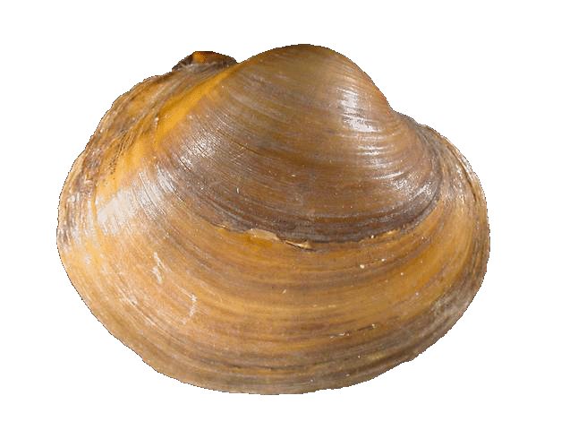
Research Species
Obovaria jacksoniana
Obovaria retusa
Obovaria olivaria
Villosa arkansasensis
Obovaria unicolor
Obovaria subrotunda

Slide 35
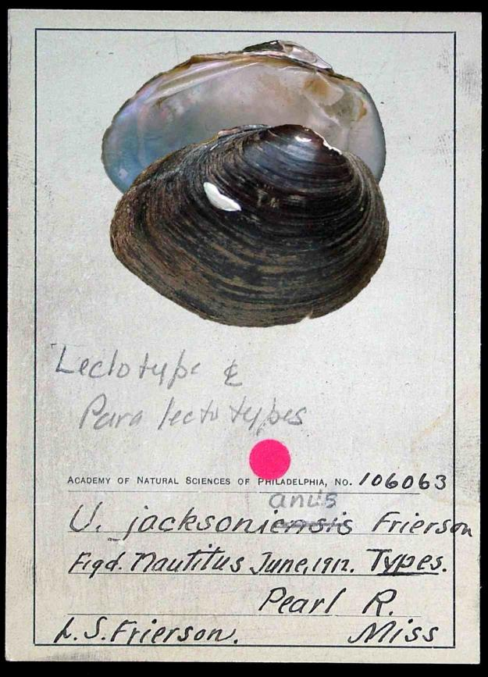
Obovaria jacksoniana (Frierson, 1912)
“Southern Hickorynut”
Pearl and Yalobusha rivers, MS (Frierson, 1912)
Interior Highland to Gulf and Mobile drainages
Species of the special concern
Global rank G2 and Arkansas rank S2
Weakly show sexual dimorphism
Long-term brooder; from late summer to the following summer
Host fish - unknown

Slide 36
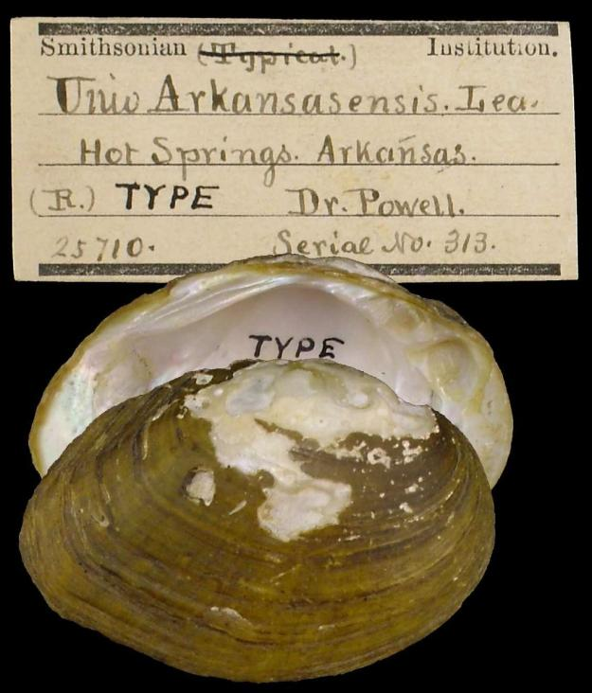
Villosa arkansasensis (Lea, 1862)
“Ouachita Creekshell”
Ouachita River near Hot Springs, AR (Lea, 1862)
Headwaters of Red river tributaries in OK and Ouachita drainages in AR
Species of the special concern
Global rank G2 and Arkansas rank S2
Sexually dimorphic
Long-term brooder; from late summer to the following summer
Host fish - Creole darter, greenside darter, green sunfish, shadow bass (Christian et al., 2007)

Slide 37
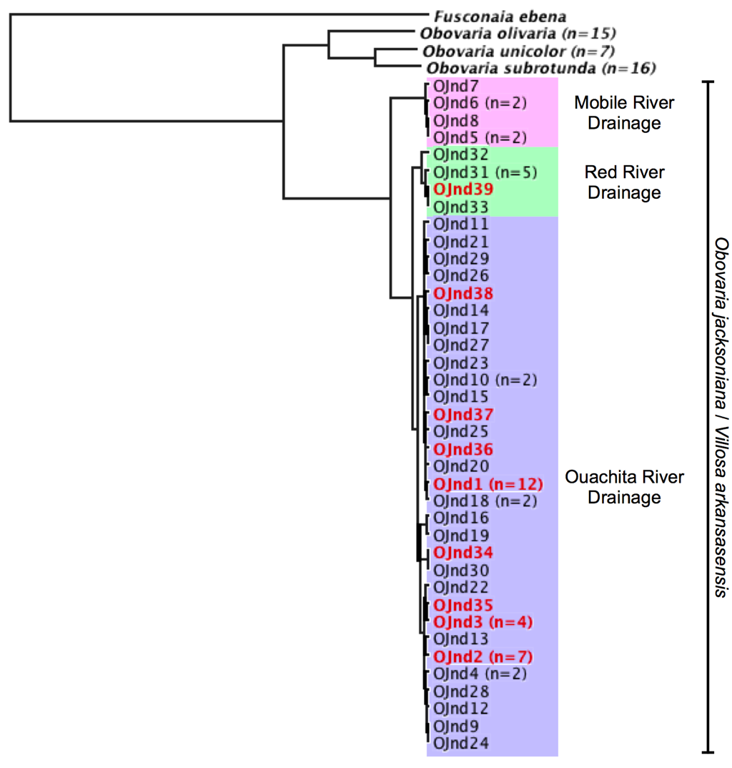
Summarized Phylogeny
Not monophyletic taxa
  Located on same phylogenetic clades
3 Distinct Phylogeographic Isolations
Notes:
Figure from Kentaro Inoue thesis, Arkansas State University, 2009.

Slide 38
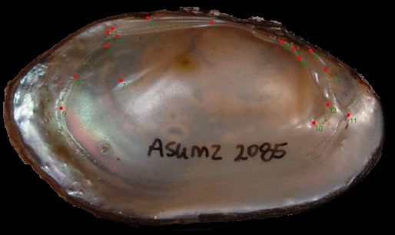


Taxonomic Analyses
DNA Sequences and Morphometrics
COI, ND1, 16S, AFLPs, Microsatellites
Geometric Morphometrics
Traditional Morphometrics

Slide 39



Slide 40






Lampsilis hydiana males
Bayou Cocodrie (Bayou Teche ) Saline River (Red R.) Lake Greeson (Ouachita R.)
Alum Fork Saline (Ouachita R.) Ouachita River, Frenchport Roc Roe Bayou (White R.)

Slide 41






Lampsilis hydiana, L. sp. A (Arkansas R.), and L. sp. B (Red R.) males
Spring Creek (Bayou Teche) Ouachita River (Ouachita R.) Ouachita River (Ouachita R.)
Lampsilis sp. A Big Piney Cr. (Arkansas R.) South Fourche La Fave R. (Arkansas R.)
Lampsilis sp. B Robinson Creek (Red R.)

Slide 42






Lampsilis hydiana females
  Bayou Cocodrie (Bayou Teche) Saline River (Red R.) Lake Greeson (Ouachita R.)
  Alum Fork Saline (Ouachita R.) Ouachita River (Ouachita R.) Roc Roe Bayou (White R.).

Slide 43






Lampsilis hydiana, L. sp. A (Arkansas R.), and L. sp. B (Red R.) females
Spring Creek (Bayou Teche) Ouachita River (Ouachita R.) Bear Creek (Arkansas R.)
Big Piney Creek (Arkansas R.) Robinson Creek (Red R.) Robinson Creek (Red R.)

Slide 44

Notes:
Map prepared by Linda DeMasi, AHTD.

Slide 45
Kiamachi and Little Rivers
Arkansas and Missouri
~ 40 species
Arkansia wheeleri
Leptodea leptodon
Pleurobema riddellii
Quadrula c. cylindrica
Quadrula fragosa
Notes:
Graphic prepared by Linda DeMasi, AHTD.

Slide 46






Lampsilis powellii, L. siliquoidea, and L. straminea males
  Saline River (Ouachita R.) Illinois R. (Arkansas R.) South Fork Ouachita (Ouachita R.)
  Middle Fork Little Red (White R.) Bogue Chitto Cr. (Tombigbee R.) Yellow Cr. (Tombigbee R. Dr.)

Slide 47
A
L. spA cf hydiana
B. L. powellii
B
Figure 18. Thin plate splines for females with L. hydiana utilized as the reference.

Slide 48






Lampsilis powellii, L. siliquoidea, and L. straminea females
South Fork Saline R. (Ouachita R.) Illinois River (Arkansas R.) Middle Fork Little Red (White R.)
Little Lemonweir R. (Wisconsin R.) Trussels Cr. (Tombigbee R.) Yellow Cr. (Tombigbee R. Dr.)

Slide 49





Lampsilis cardium and L. ornata males
  St. Francis Div. (St. Francis R.) White River (White R.) S. Fourche La Fave (Arkansas R.)
  Saline River (Ouachita R.) Saline River (Ouachita R.)

Slide 50






Lampsilis cardium and L. ornata females
  St. Francis Div. (St. Francis R.) White River (White R.). South Fourche La Fave (Arkansas R.)
  Ouachita River (Ouachita R.) Ouachita River (Ouachita R.) Saline River (Ouachita R.)

Slide 51





Little spectaclecase
Notes:
51

Slide 52




White River Drainage
“novaboracei”
Little Red River
“New Genus New Species?”

Slide 53



Western Fanshell External Morphology
Arkansas Drainage
White Drainage
Ouachita Drainage
Fanshell
White Drainage
Ouachita Drainage

Slide 54


Fanshell Conglutinates
Fanshell Fishing for a Host
Notes:
Photos A-D reproduced from Serb and Barnhart 2008. Bottom photo from Unio Gallery, M. C. Barnhart, Missouri State University.

Slide 55

Notes:
Tree reproduced from Serb and Barnhart, 2008.

Slide 56
Pleurobemini (Unionidae)
101 species, 9 genera
  Accounts for almost 1/3rd of all NA species
Most diverse genera include
  Elliptio (37 species)
  Pleurobema (35 species)
  Fusconaia (15 species)

Slide 57
Pleurobemini (Unionidae)
West of the Mississippi River
  Fusconaia
    F. askewii (TX)
    F. ebena (widespread)
    F. flava (widespread)
    F. lananensis (TX)
    F. ozarkensis (Ozark Endemic)
  Pleurobema
    P. cordatum (widespread)
    P. riddellii (TX & LA)
    P. rubrum (widespread)
    P. sintoxia (widespread)

Slide 58

Notes:
Reproduction of poster by David M. Hayes, 2010.

Slide 59












Expert Panel Ponders the Fusco-bema Question

Slide 60







P. cordatum/
F. subrotunda/
F. flava
F. askewi/lananensis
F. ozarkensis
F. cf. sampsoniana
F. flava Little R.
F. flava/cerina
Widespread
Notes:
Tree reproduced from Christian et al. 2008 report to AR Game & Fish Commission.

Slide 61



P. riddellii
Little R. & Sabine R.
Pleurobema sp.
Ouachita R.
P. rubrum/sintoxia
Widespread
Notes:
Tree reproduced from Christian et al. 2008 report to AR Game & Fish Commission.

Slide 63
Pleurobemini Results
F. ebena was not recovered within the Pleurobemini
F. askweii and F. lananensis were indistinguishable
One lineage was revealed in western Ozarks
  F. flava sampsoniana
Unique F. ‘flava’ haplotypes revealed in the Little River system
One clade recovered containing individuals morphologically identified as P. cordatum, F. flava, and P. rubrum

Slide 64




Quadrula apiculata (Say 1829)

Slide 65



Quadrula nobilis (Conrad 1853)
Notes:
Top 2 photos: Quadrula nobilis. Bottom: Q. quadrula.

Slide 66
Acknowledgements
Funding
Arkansas Game and Fish Commission
USDA – Ouachita National Forest
U.S. Fish and Wildlife Service
Advice, Assistance, Specimens
Steve Ahlstedt
Chris Barnhart
Mary Barnett
Anita Benedict
Art Bogan
Sue Bruenderman
Eric Chapman
Ron Cicerello
Betty Crump
Trey Crumpton
Kevin Cummings
Gerl Dinkins
Jeff Garner
Paul Greenhall
Wendell Haag
Paul Hartfield
Bob Hershler
Bob Howells
Christian Hutson
Bob Jones
Ron Johnson
Mark Hove
Kody Kuehnl
Monte McGregor
Stuart McGregor
Edie Marsh-Matthews
Mike Mather
Chris Mayer
Brian Obermeyer
Andy Peck
Kevin Roe
Todd Slack
Tamara Smith
Brenda Smith-Patten
Joe Stoeckel
Josh Seagraves
Sara Seagraves
Richard Standage
Joel Trexler
Tom Turner
Caryn Vaughn
Malcolm Vidrine
Jennifer Walker
Tom Watters
Larry Weider
Nathan Wentz
Rebecca Winterringer

